Slide 1
The ChapR
Add the kawaii pic from the website

Slide 2
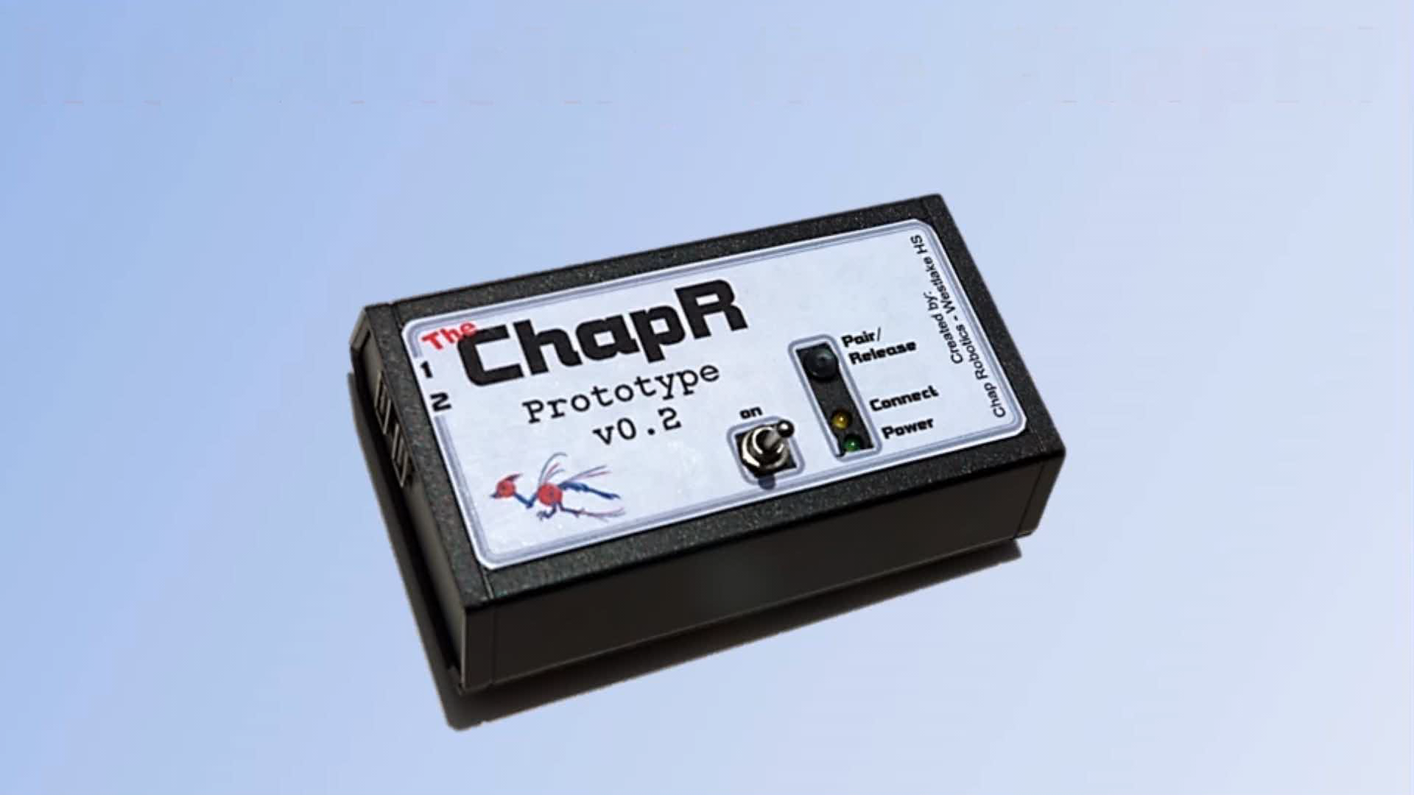

Slide 3
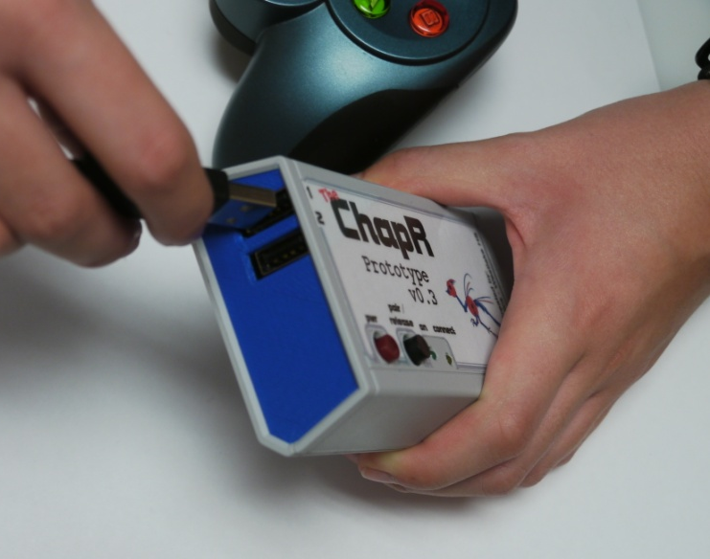
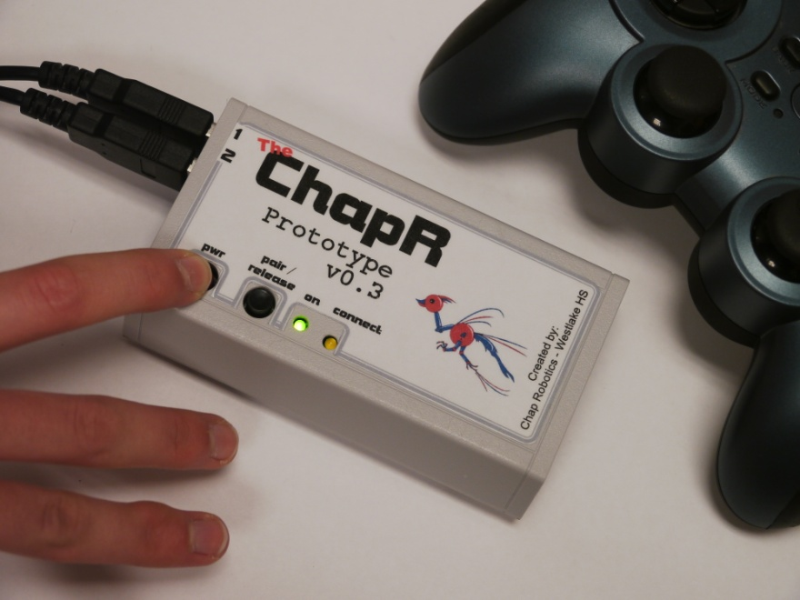
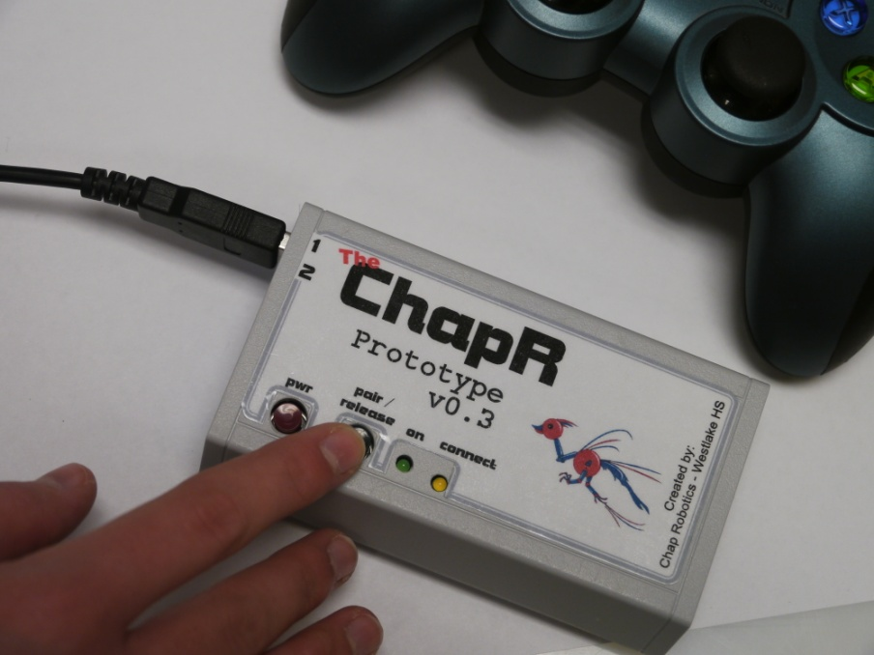
Driving
Plug in joysticks
Hold power button to turn on
Hit the WFS button if needed

Slide 4
The Kill Switch
Tap power button to abort program
TAP
Hold power button to turn off ChapR
HOLD

Slide 5
Pairing
Via Bluetooth
Hold down both buttons on the ChapR
Use NXT menus to find the ChapR and connect with it

Slide 6
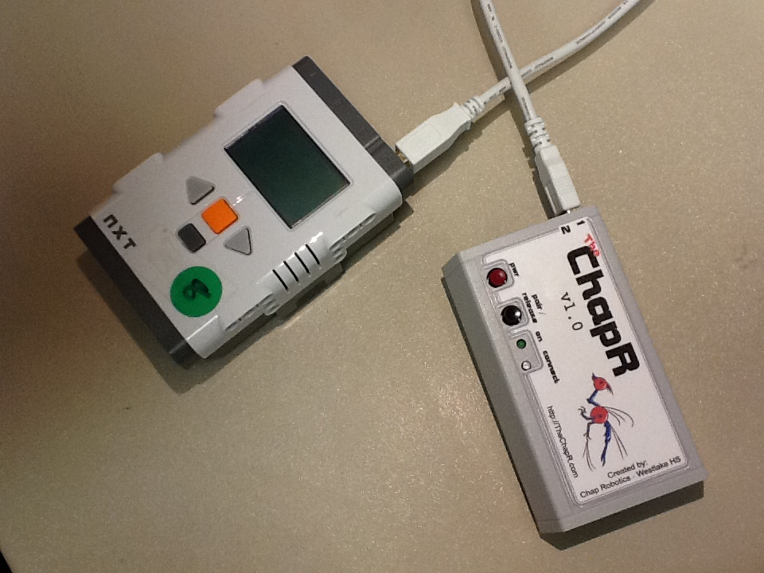
Pairing Continued
Via USB
Make sure Bluetooth is on
Plug in the cable

Slide 7
Configurable
name - the name of the ChapR as viewed by devices searching via Bluetooth (usually the NXT); must be under 15 characters; default is ChapR-whichever number ChapR you could (ex: ChapR-14)
personality - the compatibility of the ChapR; default is 1 (NXT-RobotC); click here to view details
timeout - the time before the ChapR turns itself off to save battery in minutes; 0 means no timeout; 120 minutes is the maximum; default is 10 minutes
lag - the time between sending messages; lag can be built in to simulate competition-style driving
mode - tele-op or autonomous

Slide 8
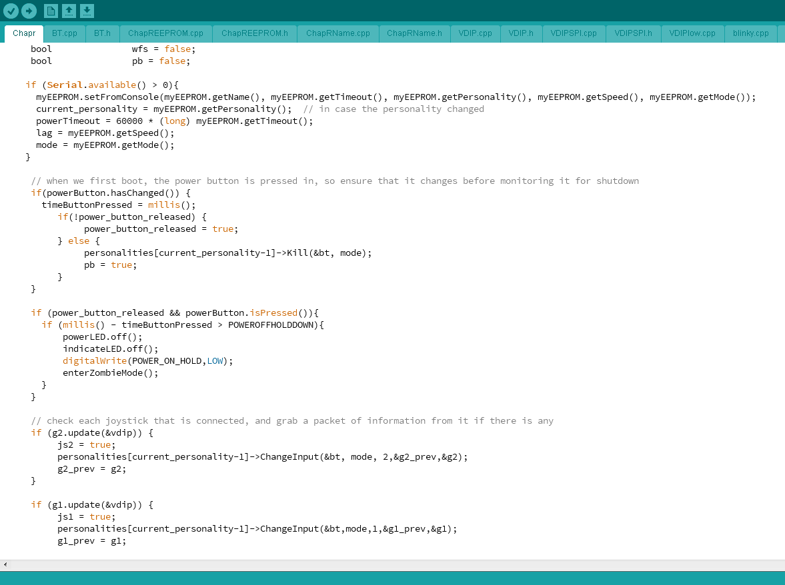
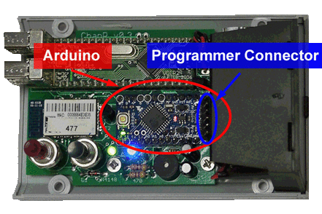
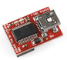
Programmable
The programmer and code on our website can be used to reprogram the ChapR

Slide 9
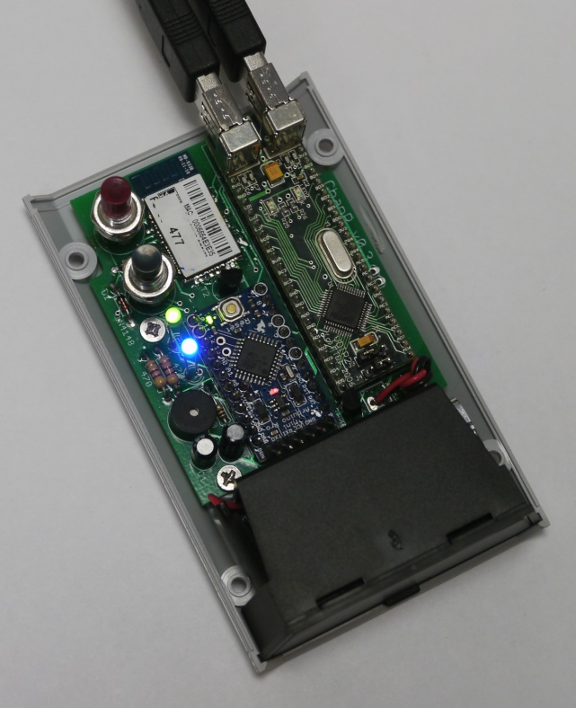
The Hardware
USB Interface:
VDIP
Insert flow chart of process and schematic
RN-42
Arduino Pro-Mini
VDIP

Slide 10
The Software
Arduino Sketch written in C
Initialize Bluetooth
Power Up
Initialize VDIP
Set Up
Read EEPROM

Slide 11
Moving Forward

Slide 12
Questions? Feedback?
Any ways to spread the word?
Advice for manufacturing or production?
General feedback?
Uses we didn’t think of?

